Slide 1
DYNAMIC
PROGRAMMING

Slide 2
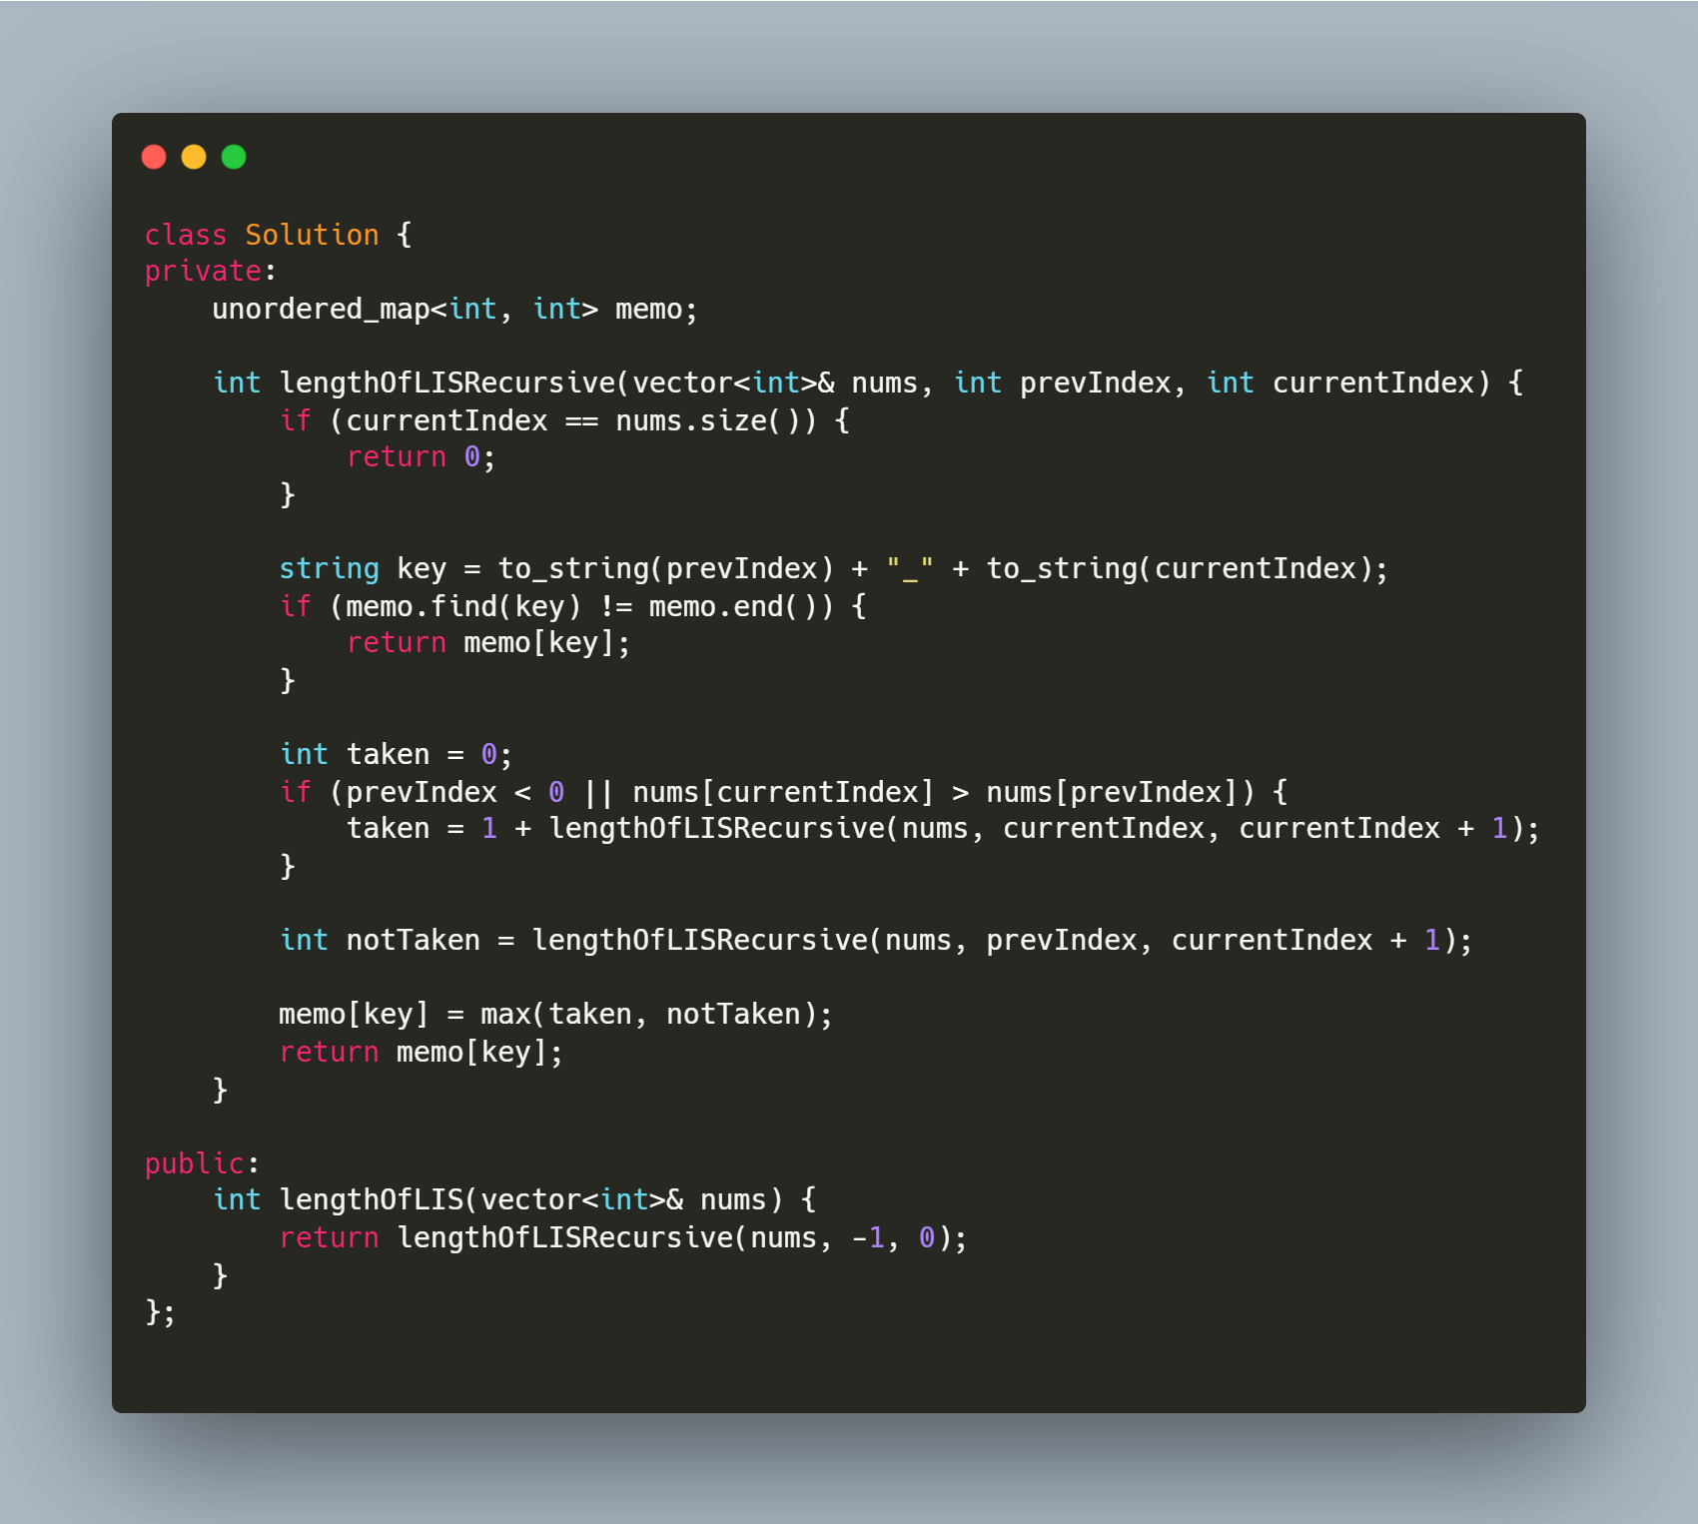
Longest increasing subsequence
Longest Increasing Subsequence
https://leetcode.com/problems/longest-increasing-subsequence/
https://leetcode.com/problems/largest-divisible-subset/
https://leetcode.com/problems/russian-doll-envelopes/
https://leetcode.com/problems/maximum-length-of-pair-chain/
https://leetcode.com/problems/number-of-longest-increasing-subsequence/
https://leetcode.com/problems/delete-and-earn/
https://leetcode.com/problems/longest-string-chain/

Slide 3
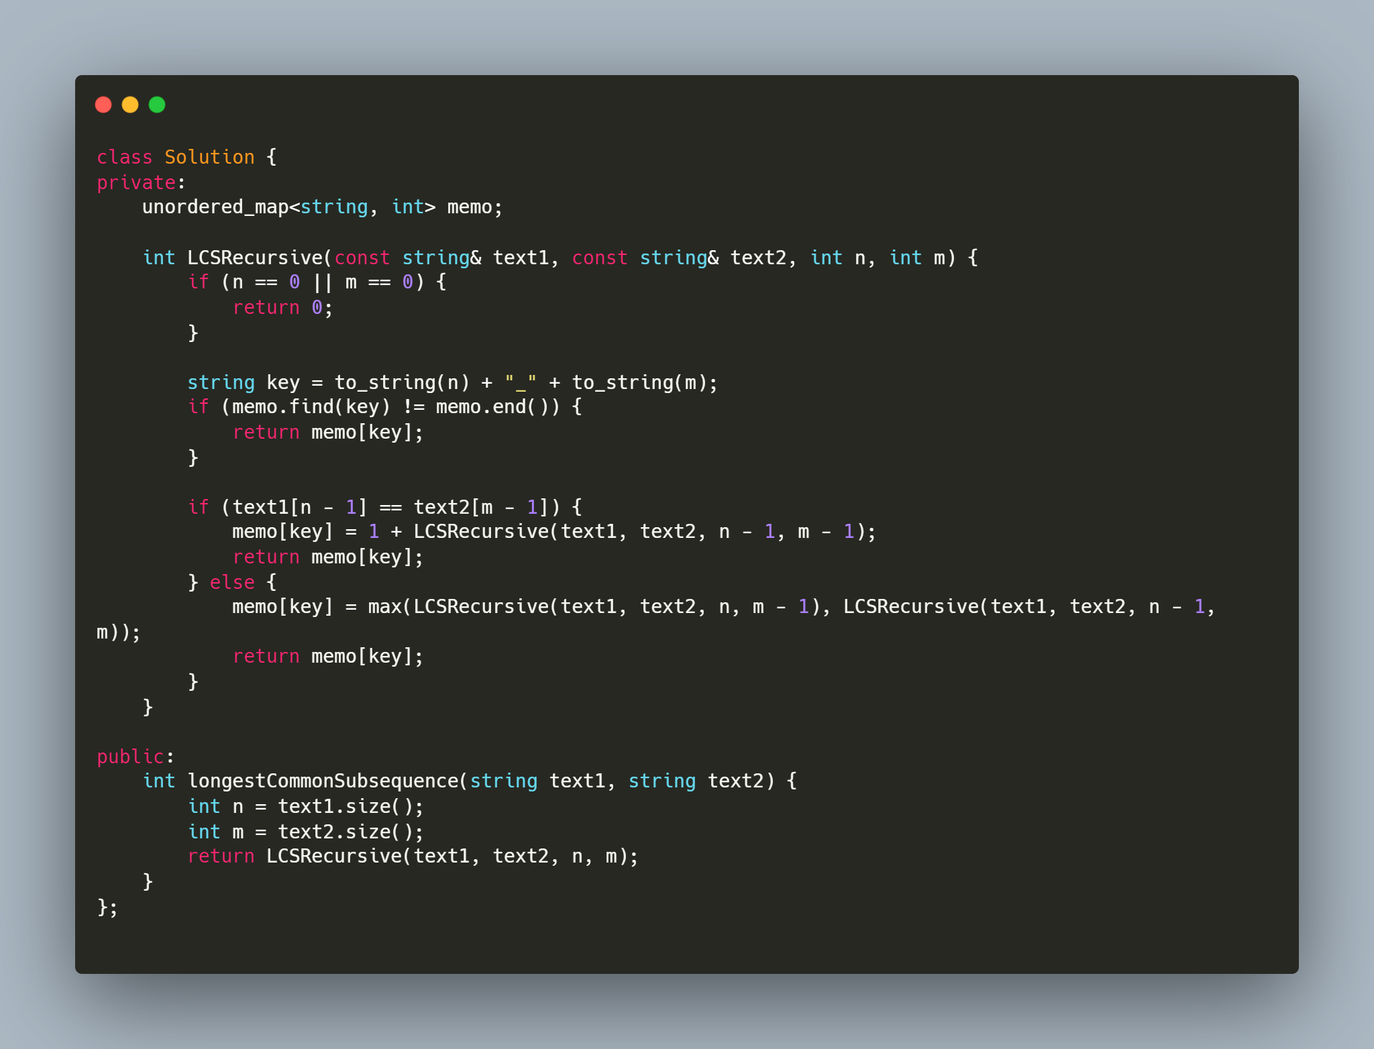
Longest common subsequence
Longest Common Subsequence
https://leetcode.com/problems/longest-common-subsequence/
https://leetcode.com/problems/edit-distance/
https://leetcode.com/problems/distinct-subsequences/
https://leetcode.com/problems/minimum-ascii-delete-sum-for-two-strings/

Slide 4
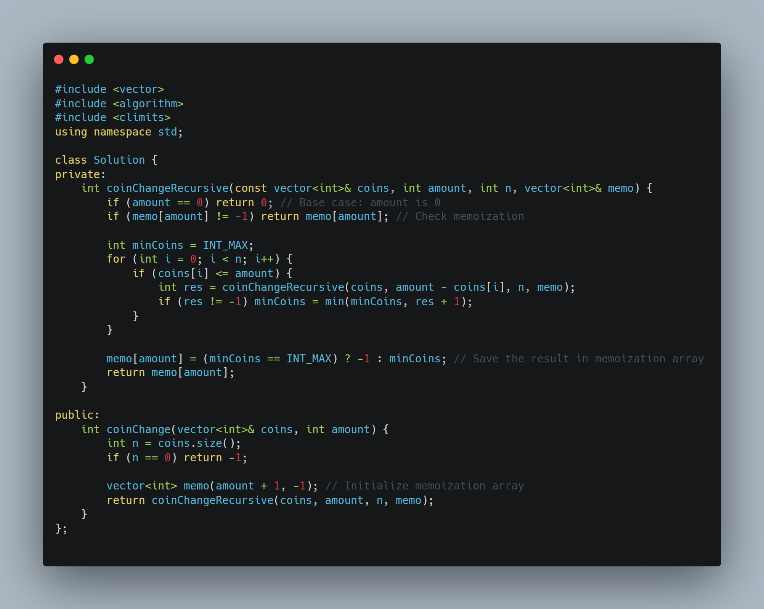
Coin change
Coin Change:
https://leetcode.com/problems/coin-change/
https://leetcode.com/problems/coin-change-2/
https://leetcode.com/problems/combination-sum-iv/
https://leetcode.com/problems/perfect-squares/
https://leetcode.com/problems/minimum-cost-for-tickets/

Slide 5
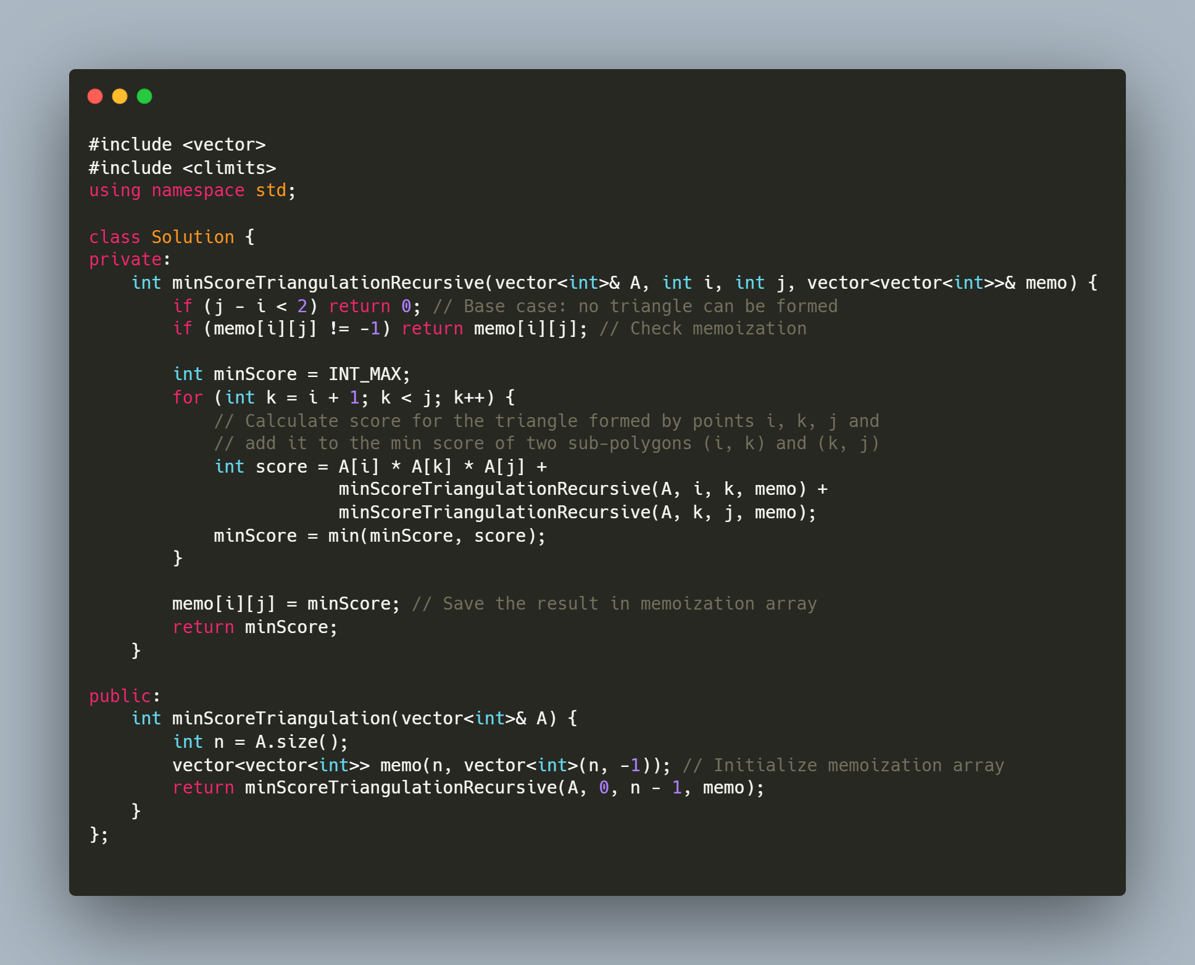
Matrix multiply
Matrix multiplication:
https://leetcode.com/problems/minimum-score-triangulation-of-polygon/
https://leetcode.com/problems/minimum-cost-tree-from-leaf-values/
https://leetcode.com/problems/burst-balloons/

Slide 6
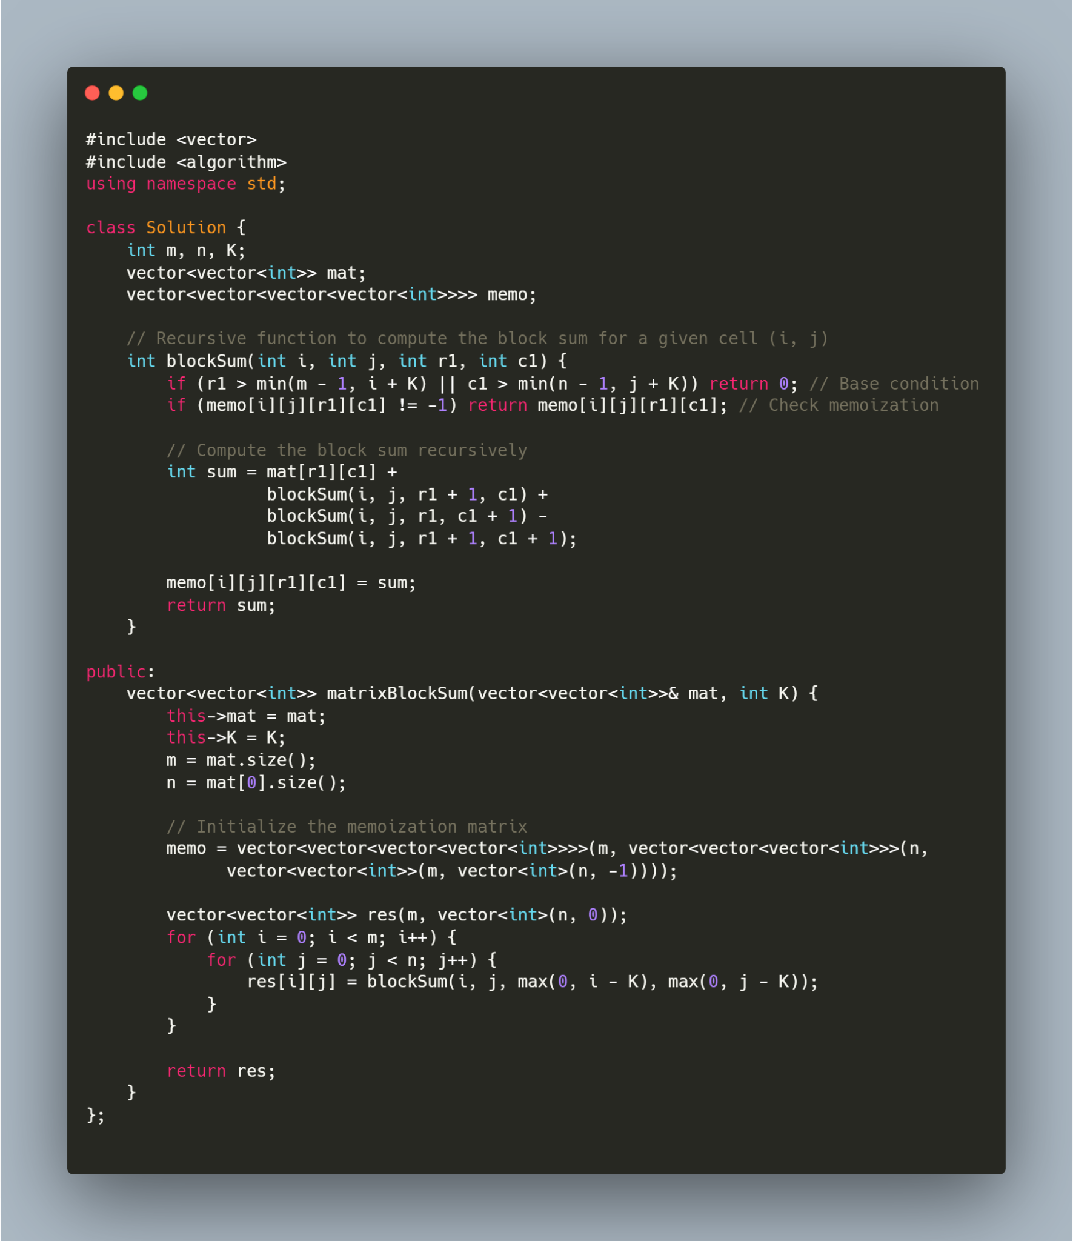
Matrix 2d array
Matrix/2D Array:
https://leetcode.com/problems/matrix-block-sum/
https://leetcode.com/problems/range-sum-query-2d-immutable/
https://leetcode.com/problems/dungeon-game/
https://leetcode.com/problems/triangle/
https://leetcode.com/problems/maximal-square/
https://leetcode.com/problems/minimum-falling-path-sum/

Slide 7
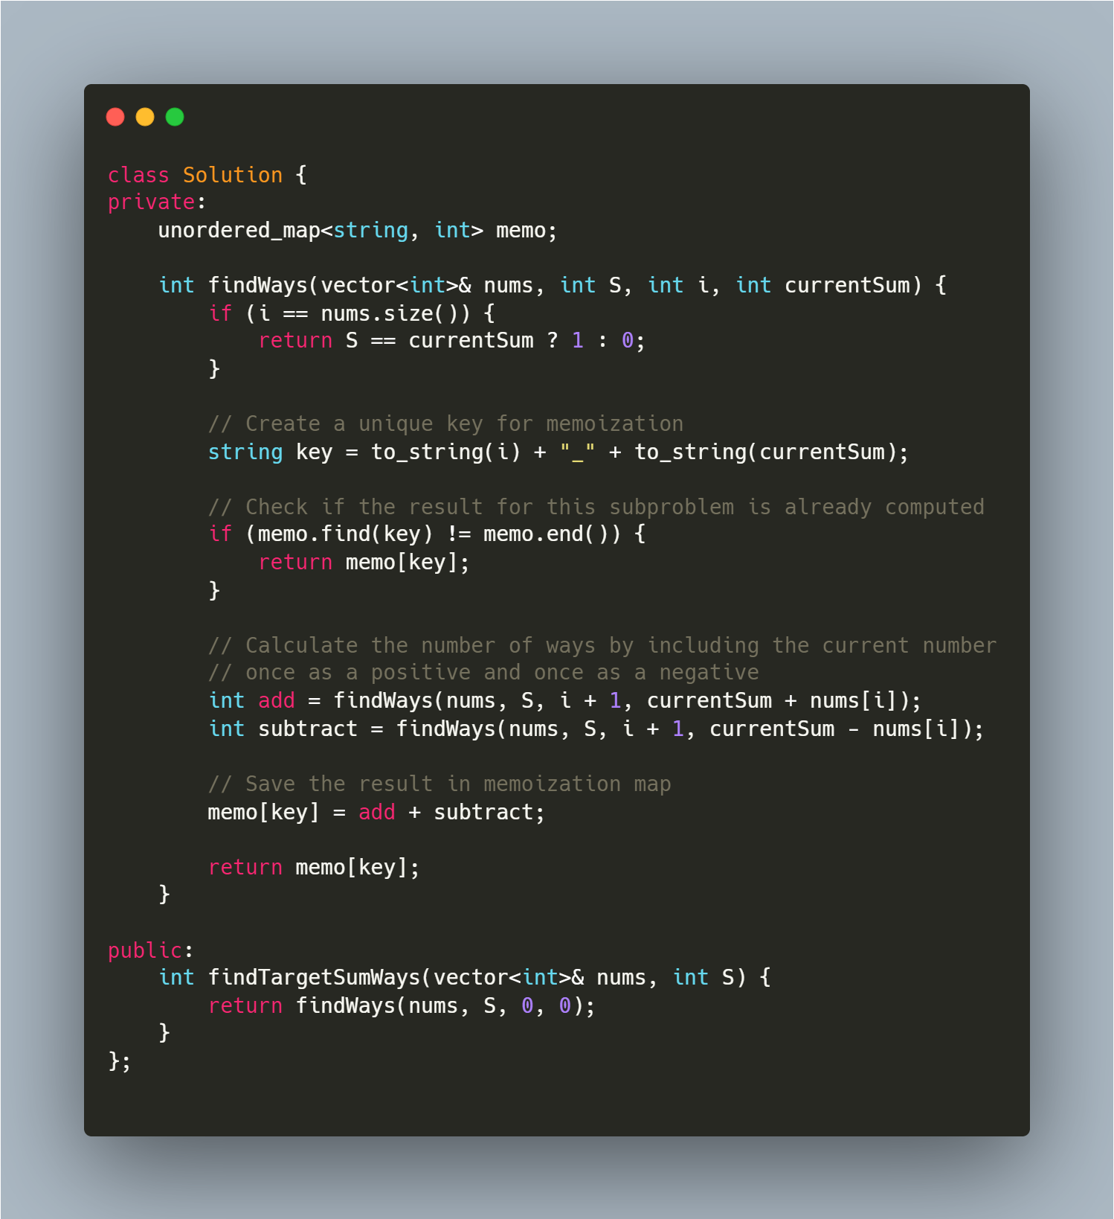
Hash DP
Hash + DP:
https://leetcode.com/problems/target-sum/
https://leetcode.com/problems/longest-arithmetic-sequence/
https://leetcode.com/problems/longest-arithmetic-subsequence-of-given-difference/
https://leetcode.com/problems/maximum-product-of-splitted-binary-tree/

Slide 8
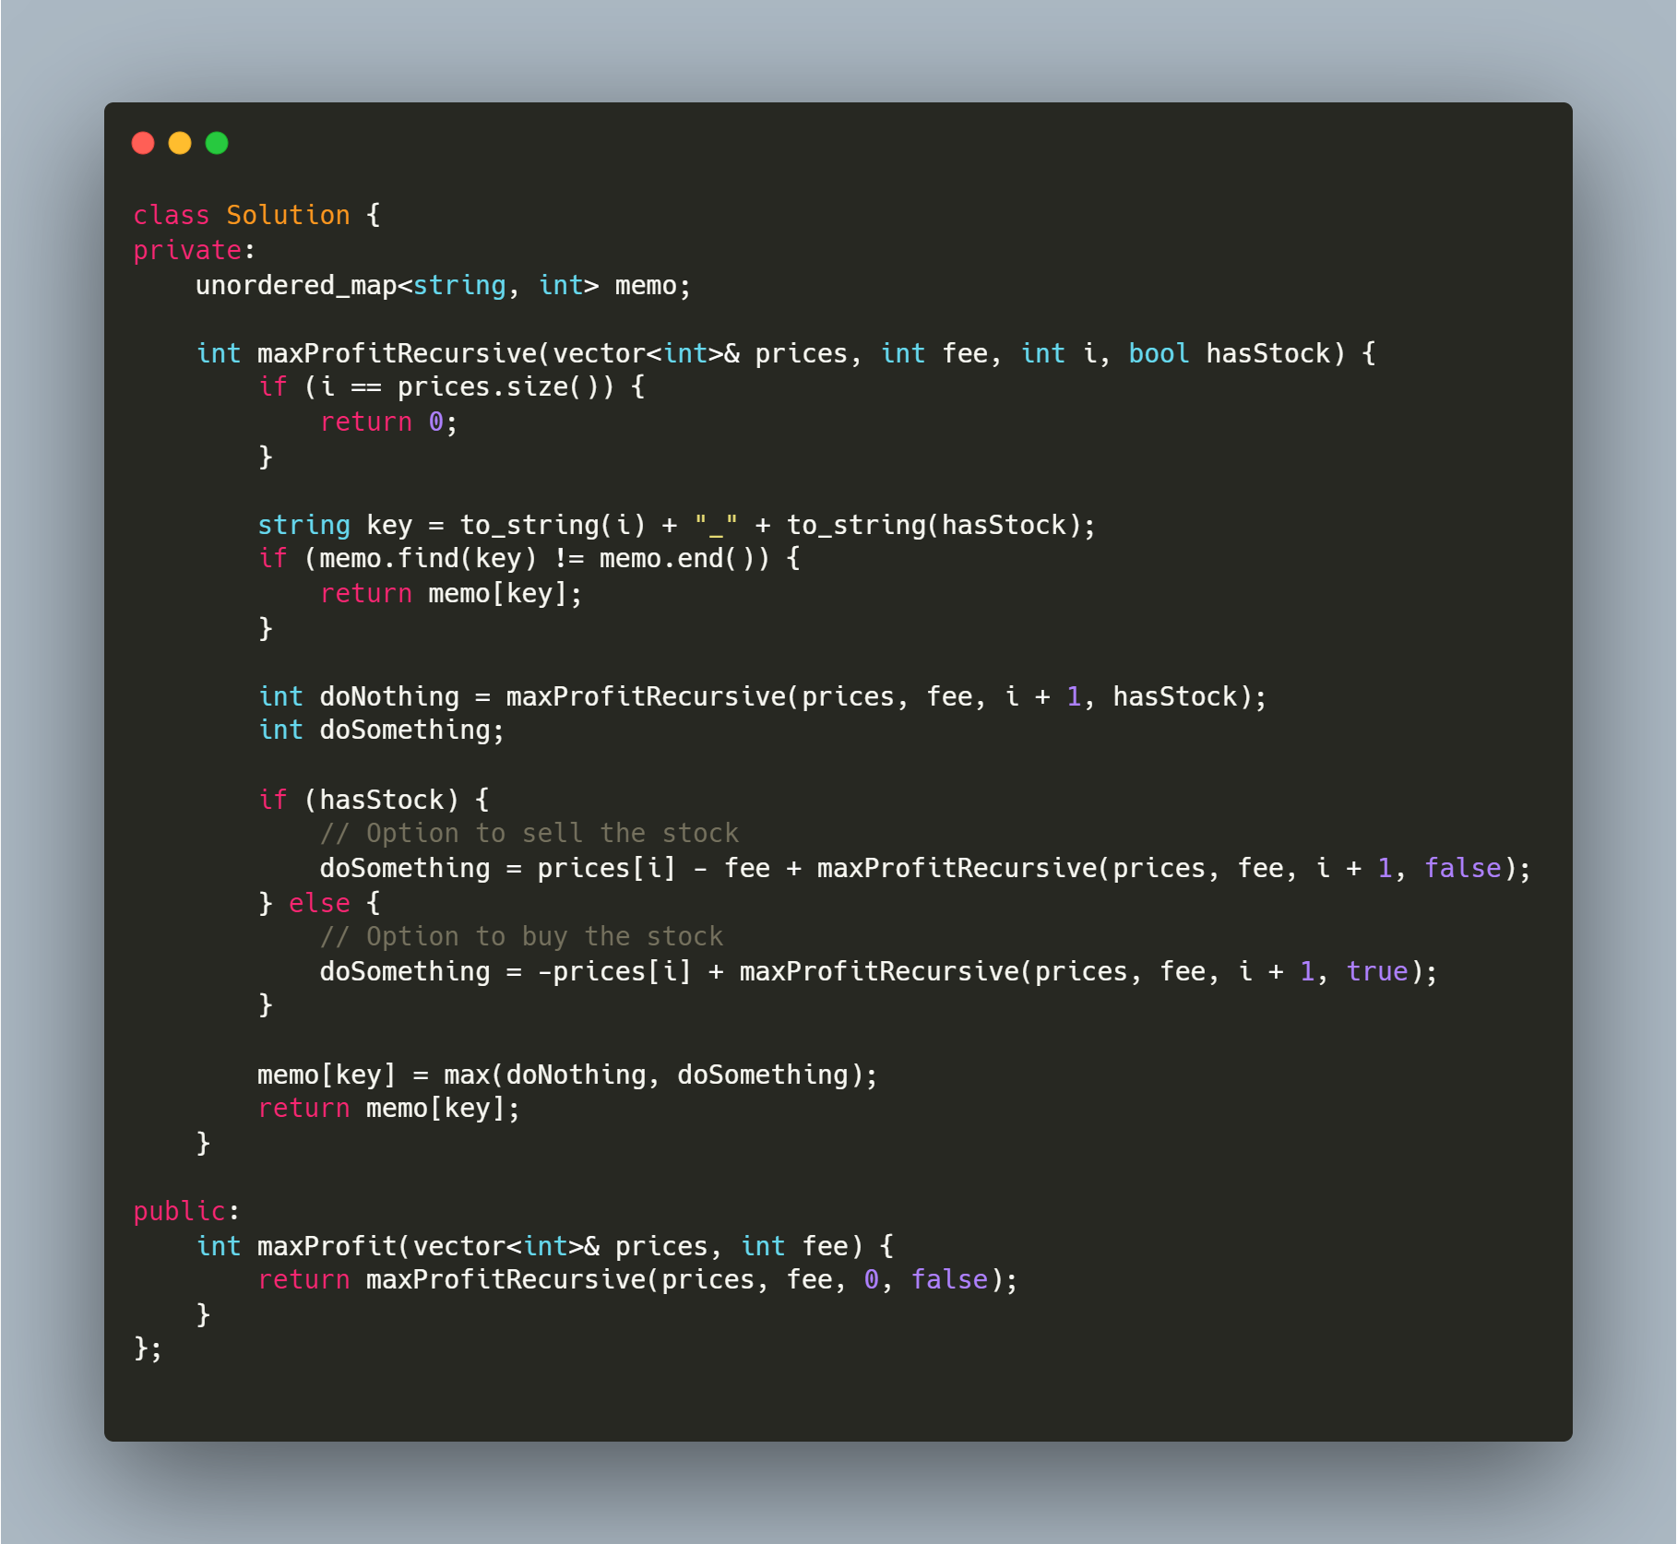
State machine
State machine:
https://leetcode.com/problems/best-time-to-buy-and-sell-stock/
https://leetcode.com/problems/best-time-to-buy-and-sell-stock-ii/
https://leetcode.com/problems/best-time-to-buy-and-sell-stock-iii/
https://leetcode.com/problems/best-time-to-buy-and-sell-stock-iv/
https://leetcode.com/problems/best-time-to-buy-and-sell-stock-with-cooldown/
https://leetcode.com/problems/best-time-to-buy-and-sell-stock-with-transaction-fee/

Slide 9
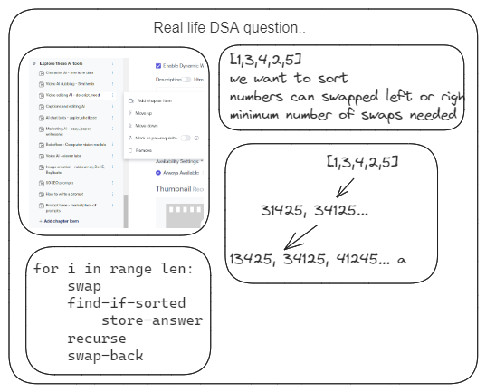
Real life

Slide 10
Leetcode articles
https://leetcode.com/discuss/general-discussion/665604/Important-and-Useful-links-from-all-over-the-Leetcode
https://leetcode.com/discuss/general-discussion/458695/dynamic-programming-patterns

